Slide 1


Las Vegas
Presented By:
Jairo Martinez
Creating Basic “Custom” Directives

Slide 2
Topics We Will Cover…..hopefully
What Are Directives?
Some Common AngularJS Directives
Inside A Directive
Overview (Example)
Naming
The Return Object
Restrict
Scope
Controller
Link and More…
“And Then Show Some Examples Of Directives”

Slide 3
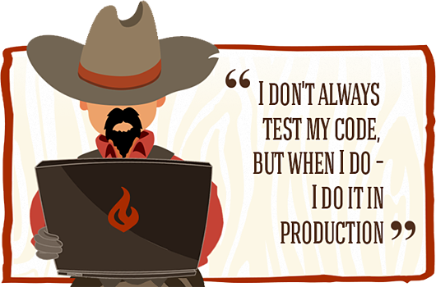
Some Prerequisites
Knowledge Of HTML & JS
Basic Knowledge AngularJS
Know how to create a basic app.
Understand a bit about Controllers and Scope.
…and Patience (with me).

Slide 4
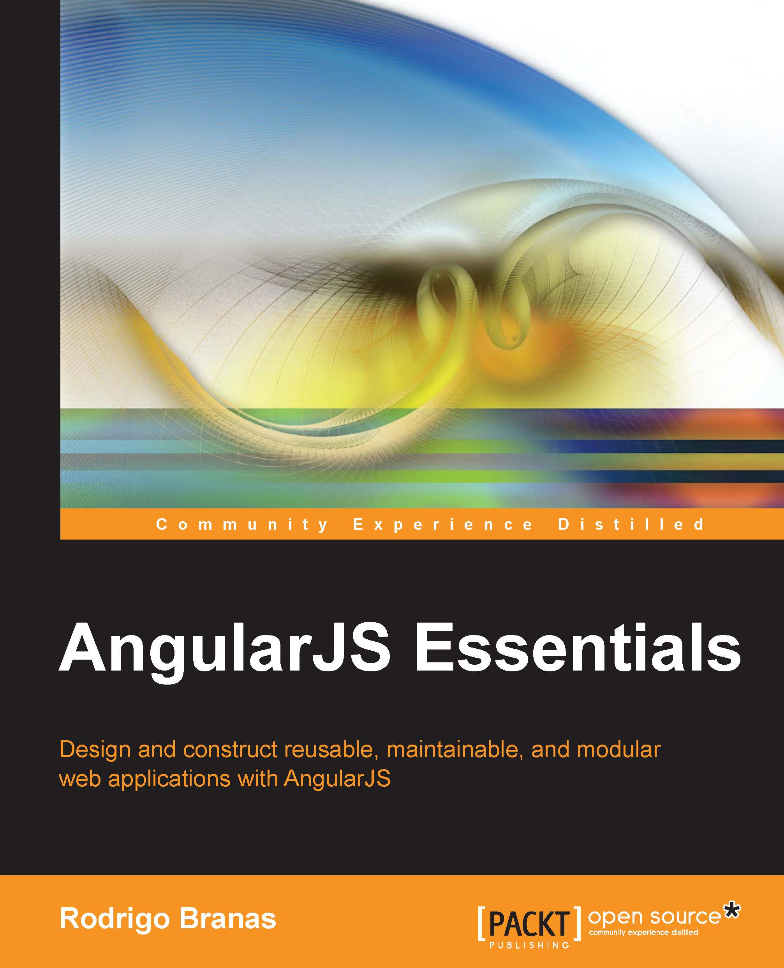
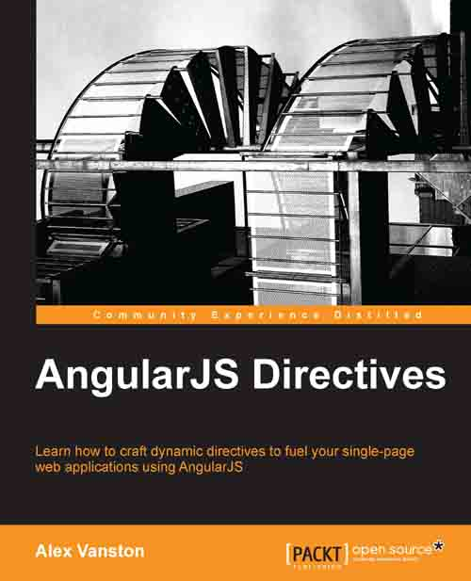
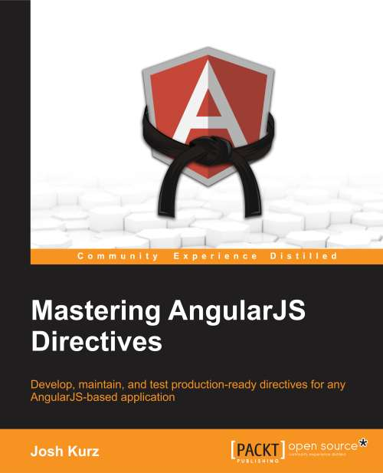

Find Out More…
Plenty of Books on the Subject
Video Courses from many sites such as:
TutsPlus, Code School, Plural Sight, Lynda, and more…
Egghead IO is a great resource as well.
Egghead.io

Slide 5
Part 1: What Are Directives?
A quote from AngularJS.org:
“Directives is a unique and powerful feature available only in Angular. Directives let you invent new HTML syntax, specific to your application.
We use directives to create reusable components. A component allows you to hide complex DOM structure, CSS, and behavior. This lets you focus either on what the application does or how the application looks separately. ”
Template-expanding Directives are the simplest form of a directive:
- define a custom tag, attribute, or class that is expanded or replaced and can include Controller logic, if needed.
Directives can also be used for:
• Expressing complex UI • Calling events and registering event handlers
• Reusing common components

Slide 6

Some Common AngularJS Directives.
Did you know that you have already been using Directives (the built-in kind):
ngModel
ngRepeat
ngShow
ngHide
ngBind
ngView
ngSwitch
…and many more

Slide 7


Check-In Quiz
What is a directive?
Name Some Built-In Directives.
Who Shot First?

Slide 8
Inside A Directive: Overview
You can create your app and directive a few different ways.
These are the two most commonly used methods.

Slide 9
Inside A Directive: Naming
Naming Conventions:
Building the directive, use “camelCase” (myCustom)
From within the HTML DOM:
1. my-custom * 3. my:custom 5. data-my-custom
2. my_custom 4. x-my-custom
* The “-” is the preferred method (in my opinion and AngularJS).
If you want to be HTML5 compliant, then add the “x-” or “data-” to your directive
If the name of your directive is a single work like “event”,
then just keep it lowercase

Slide 10
Inside A Directive: Return Object
Property/Func | Basic Description
restrict | How the directive will be used: E - Element, A - Attribute, C - Class, M – Comment. You can use multiple options. (Default is A)
scope | Use to inherit from parent, create a child or an isolated scope
template | The content that should be output from the directive. Can include HTML, data binding expressions, and even other directives.
templateUrl | The path to the template that should be used by the directive. It can optionally contain a DOM element id when templates are defined in <script> tags ( aka Template Cache).
controller | Used to define a controller that will be associated with the directive template. (Internal or External)
link | Function used for DOM manipulation tasks.

Slide 11
Inside A Directive: Return Object
Some additional items that can be returned:
Replace (true or false)
Remove the custom tag or leave it
Priority (0 – ?) [Order Of Execution/Compiling]
Terminal (true or false)
Transclude (true or false)
Require (false or another directive with ‘^’ or ‘?’)
Compile (function that returns a link object)
Pre (function)
Post (function)
Does not have access to scope.

Slide 12
Inside A Directive: Restrict
Directives Implementations (‘restrict’) Come In 4 Types:
A new HTML Element <Tag> ( <my-custom></my-custom> )
An Attribute ( <input type=“text” data-my-custom /> )
As A Class ( <h1 class=“my_custom”></h1> )
Comment ( <!--directive:my-custom --> )
“A”, for attribute, is the default behavior.
Best Practice: Prefer using directives via tag name and attributes over comment and class names. Doing so generally makes it easier to determine what directives a given element matches. (AngularJS.org)

Slide 13
Inside A Directive: Scope
Scope:
Parent – This is the default behavior, in where the directive gets the parent’s scope.
Child – Is where the scope will prototypically inherit from the parent’s scope but can have some of its own properties not visible to the parent.
Isolated – This scope does not inherit from the parent and exists on its own. This is the ideal usage when you want to make this directive reusable.
How to implement:
Parent → scope: false (or don’t add to return object)
Child → scope: true
Isolated→ scope: {}

Slide 14
Inside A Directive: Isolated Scope
Isolating a scope does not preclude it from being able to bind it to aspects of the parent’s scope
Three ways to bind to parent scope:
@ - binds the value of parent scope property (which always a string) to the local scope.
= - binds parent scope property directly which will be evaluated before being passed in.
& - binds an expression or method which will be executed in the context of the scope it belongs.

Slide 15
Inside A Directive: Template(Url)
Template:
Can be just plain HTML which is to be inserted.
template: ‘<h1>Insert Me Please</h1>’
template: ‘<input type=“text” value=“{{userName}}” />’
TemplateUrl:
Points to the location of the “partial” html file
templateUrl: ‘./views/form.html’
templateUrl: ‘navBar.html’ (Template Cache)
Best Practice: Unless your template is very small, it's typically better to break it apart into its own HTML file and load it with the templateUrl option. (AngularJS.org)

Slide 16
Inside A Directive: Controller
Can create a new controller or pass in a controller from the parent.
Declare Controller
Option to set the name of Controller by using “controllerAs:”

Slide 17
Inside A Directive: Link
The link function is mainly used for attaching event listeners to DOM elements, watching model properties for changes, and updating the DOM.
Arguments passed into the link function must be placed in a specific order (unlike a controller):
Scope
Element
Attributes

Slide 18
Inside A Directive: Link using jqLite
A basic set of the jQuery framework is available to use when manipulating the DOM:
addClass()
after()
append()
attr() - Does not support functions as parameters
bind() - Does not support namespaces, selectors or eventData
children() - Does not support selectors
clone()
contents()
css() - Only retrieves inline-styles, does not call getComputedStyle()
data()
detach()
empty()
eq()
find() - Limited to lookups by tag name
hasClass()
html()
next() - Does not support selectors
on() - Does not support namespaces, selectors or eventData
off() - Does not support namespaces or selectors
one() - Does not support namespaces or selectors
parent() - Does not support selectors
prepend()
prop()
ready()
remove()
removeAttr()
removeClass() removeData() replaceWith()
text()
toggleClass() triggerHandler() - Passes a dummy event object to handlers.
unbind() - Does not support namespaces
val()
wrap()

Slide 19
Check-In Quiz: Is This Directive Valid?
Restrict, scope, and link are the default options

Slide 20
Check-In Quiz: What’s Wrong With It?
Can not be ‘Camel Case’. Change To simple-directive
Can only be used as type class

Slide 21
Check-In Quiz: What’s Wrong With It?
Can only be used either as Element or Attribute
lastName must be renamed to last-name=‘Bird’
Directive name must start with lower-case letter.
The link function parameters are in the wrong order

Slide 22
Demonstrations Of Directives
Lets now look at some basic examples of directives
…and try not to laugh to hard at my examples. ☺
Demo files for this presentation are available @:
https://github.com/Zenitram-Oriaj/AngularJS_Directives

